Slide 1
UCAS and Post 18 Parent Information Evening

Slide 2
Miss Rodin Head of Year 13

Slide 3
Achieving Excellence With Care
What is UCAS?
UCAS (Universities and Colleges Admissions Service) is the system through which students will apply to university.
Students have logged onto the UCAS website and filled in some of their details, produced at least 3 drafts of a personal statement and researched possible university course choices.
Teachers have written subject references for all students.

Slide 4
Achieving Excellence With Care
Key dates
September | Parent information evening Personal Statements should have had a second draft
15th October | Final deadline for Oxbridge, Medicine, Veterinary & Dentistry applicants
End of Christmas term 2018 | Deadline for all other applications
March 2019 | Deadline for some art and design courses
5th July 2019 | Clearing opens
15th August 2019 | A-Level Results day

Slide 5
Achieving Excellence With Care
Making choices
2 optimistic choices (slightly above your predicted grades)
2 realistic choices (equal to your predicted grades)
1 safe choice (slightly below your predicted grades)

Slide 6
Achieving Excellence With Care
References
Possibly the most important part of the process, a reference is the school’s endorsement of the student.
We have to be honest – cannot hide poor punctuality, attendance or attitude.
Predicted grades will be optimistic but honest – these are non-negotiable, as the teachers will have the best picture of what the student is capable of.
We do not want to set them up to fail.

Slide 7
Achieving Excellence With Care
How do I support?
Check progress with personal statements, UCAS applications and University choices.
Use www.advancingaccess.ac.uk/cpd-resources/content/choose-a-university
Contact form tutors if you have any queries/concerns

Slide 8
Achieving Excellence With Care
How do I support?
In your packs there are:
Possible questions to support their application.
3 examples of personal statements.
A personal statement checklist and structure.
Guide for filling in the UCAS application.

Slide 9
Achieving Excellence With Care
Opening statement
I remember vividly when the news relayed the details of the John Worboys case. Though I was only seven and did not understand the true heinousness of the crime, I could tell by that this moment was important. That stayed with me for a long time. I followed the development of the claimants' subsequent decision to appeal to the European Court of Human Rights as they attempt to sue the Metropolitan Police for their treatment when reporting their attacks. Whilst there is not yet a verdict, it throws light upon the treatment that women are subjected to in the criminal justice system.

Slide 10
Achieving Excellence With Care
Talking about your subject
Artificial Intelligence interests me as it explores how we can use algorithms to create intelligent agents. In order to discover more about this, I attended a lecture at University College London on traffic algorithms, which showed how data from traffic jams can be collected and used to create algorithms for predicting traffic, using sensors placed in traffic lights. This was an unexpected application of AI technology, which made me appreciate the range of problems that AI can solve. This led me to read Artificial Intelligence: A Modern Approach; reading about more complex concepts such as neural networks and general intelligence made me think deeply about just how far a computer agent can be made to function like a human. Machine learning is the area of AI that intrigues me the most; the idea of algorithms being able to learn while not being programmed where to look is both challenging and thought provoking. I am positive that creating a computer agent that can think and learn effectively will have a massive impact on our lives very soon.

Slide 11
Ms Bridges Medical Applications

Slide 12
Science and Medical applications
12.5 applicants per place last application, Jeremy Hunt increasing number of places from 6,000 to 7,500 this entry in order to help NHS be self sufficient.
UKCAT – 26 Medical Schools require it
BMAT – 7 Medical Schools require it
Only applicants scoring highly (within a particular cohort – no grade boundaries) will be considered for interview
Half applicants rejected straight out, half go to interview – either a panel interview or multiple mini interviews, testing scientific knowledge and asking about experience
<0.1% of applicants receive unconditional offer
Offers range from A*A*A – AAA (Including Chemistry and Biology (or Maths))

Slide 13
Ms Pearce Head of Sixth Form

Slide 14
STUDENT FINANCE ENGLAND
SECTION 1

Slide 15
STUDENT FINANCE ENGLAND
AN INTRODUCTION
Student Finance England provide financial support on behalf of the UK
Government to students from England entering higher education in the UK:
The two main costs full-time students will have while studying are
tuition fees and living costs.
Student finance is available to help you with both.
Depending on your circumstances, your course and where you study, you
may be able to get a range of financial help and support.
You could get grants and bursaries (which you don’t have to pay back) and loans (which you do).

Slide 16
Tuition Fee Loan
Extra support
SECTION 3
SECTION TITLE IN HERE
SUBHEADER IN HERE
Student
Finance
Package
Maintenance
support

Slide 17
TUITION FEES AND LOANS
AN OVERVIEW
Universities and colleges can charge new full-time students up to
£9,250 per year in tuition fees.
Eligible students won’t have to pay any tuition fees up front.
A Tuition Fee Loan is available to cover the fee charged by a university
or college.
A Tuition Fee Loan doesn’t depend on household income.
SFE pay your Tuition Fee Loan directly to your university or college.
The loan is repayable, but only when your income is over £21,000.
You have 30 years to pay your tuition fee off.
Notes:
Personal Eligibility
Where you live
Normally you must be living in the UK on the first day of the first academic year of your course and ‘ordinarily resident’ in the UK for three years immediately before this date.
‘Ordinarily resident’ means where you usually live, apart from temporary or occasional absences.
Exceptions
If the student, their spouse, civil partner, parent/step-parent are recognised by the government as a refugee and lived in this country since this status was awarded.
If the student, their spouse, civil partner, parent/step-parent, have been granted Humanitarian Protection to stay in the UK by the Home Office, resulting from a failed asylum application.
If student is the child of a Swiss national or Turkish worker, and been ordinarily resident in the EEA and Switzerland/Turkey for the three year period immediately before the first day of the first academic year of their course
Course Eligibility
The course studied must be in the UK and one of the following:
• a first degree, eg BA, BSc or BEd
• a Foundation Degree
• a Certificate of Higher Education
• a Diploma of Higher Education (DipHE)
• a Higher National Certificate (HNC)
• a Higher National Diploma (HND)
• a Postgraduate Certificate of Education (PGCE)
• Initial Teacher Training (ITT)
Previous Study
Students won’t normally be able to get a Tuition Fee Loan if they already hold a qualification equal to or higher than the one they plan on studying for.
If they have already received student finance for part of a course that they didn’t complete they will only be able to receive finance for the number of years of the course, less the number of years they already had funding for.

Slide 18
MAINTENANCE LOAN
MAXIMUM LEVELS 2018/9
£
Parental home
Live at home while you study
Up to
£7, 324
Up to
£8, 700
Elsewhere
Live away from home & study outside London
£
London
Live away from home & study in London
Up to
£11,354
i
If studying overseas as part of a UK course, Maintenance Loan support is still available. Up to £9, 963 for 2018/9

Slide 20
Extra Support
This is bursaries / scholarships.
It is not standard across all universities.
Do not let this dictate what university you are going to go to.
These are grants- do not have to pay it back.

Slide 21
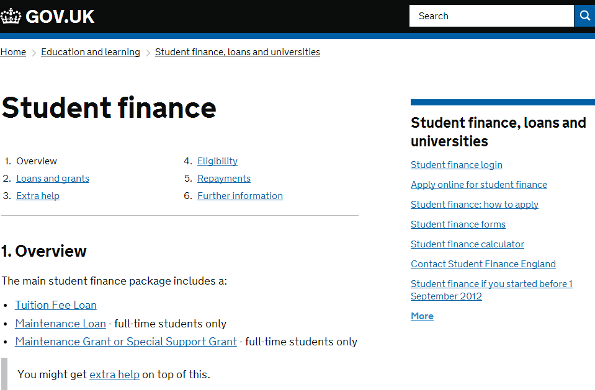
GET YOUR ESTIMATE
www.gov.uk/studentfinance
A
Activity 1 – By using the calculator on gov.uk you can get an estimate of the student finance which may be available to you and make a note of the results in your work book.
Notes:
Click on gov.uk link to go to calculator!!

Slide 22
Not the same type of loan as any other. It is more a ‘salary determined graduate job tax’

Slide 23
Mr O’Brien Deputy Head of Sixth Form

Slide 24
Achieving Excellence With Care
Post 18 Options
Other than University there are a number of pathways the students can choose:
Employment
Apprenticeships
Degree Apprenticeships
Mr Todd has links to a significant number of external organisations and businesses to support boys with accessing relevant vacancies, applications and gaining soft skills (CV writing, interview technique etc).
Partner organisations include WhiteHat (apprenticeship agency, TfL, Network Rail, The Brokerage, PwC, Pathway CTM)

Slide 25
Any questions?

