Slide 1
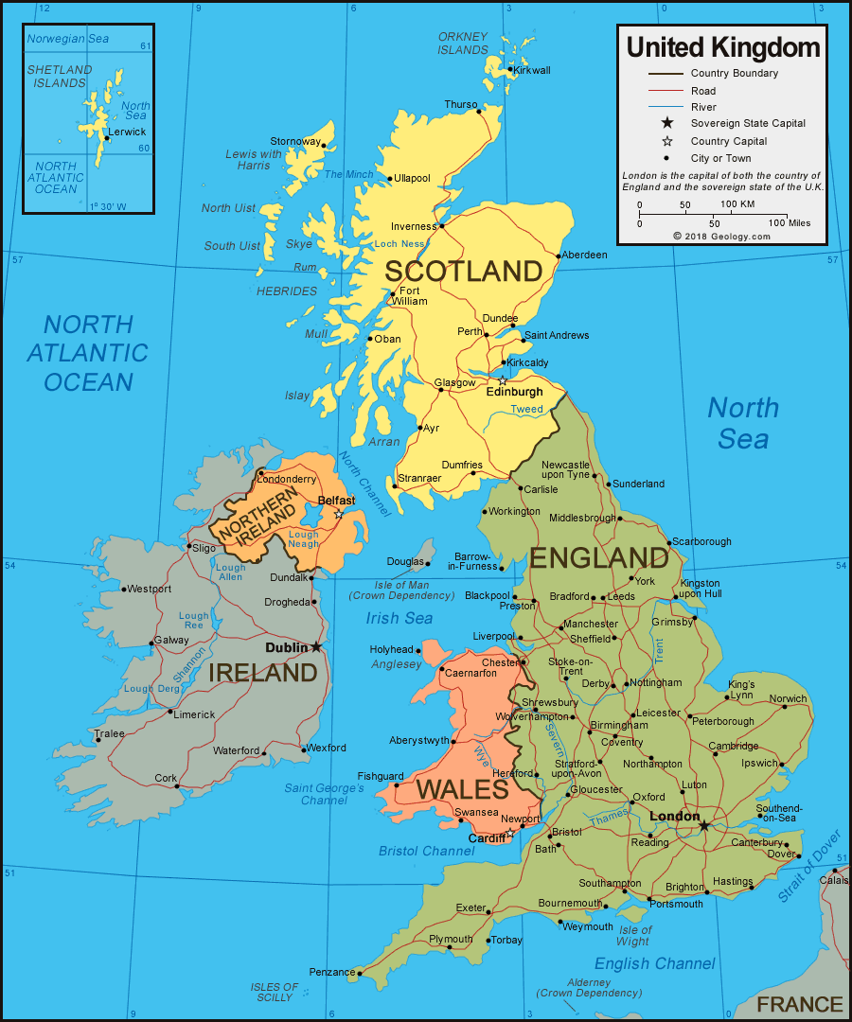
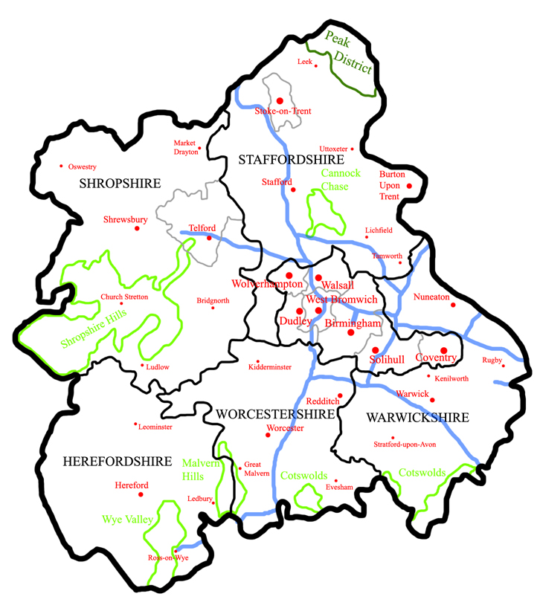
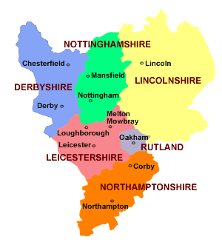

Slide 2
University of Oxford
University of Cambridge
Imperial College
UCL
LSE
University of Edinburgh
King’s College London
University of Manchester
University of Bristol
University of Warwick
11.University of Glasgow
12. University of Sheffield
13.Durham University
14. University of Birmingham
15. University of Southampton
16. University of York
17. Queen Mary, University of London
18. University of Exeter
19. Lancaster University
20. University of Nottingham

Slide 3
Law and Criminology
University of Birmingham
AAA
Social Policy
University of
Birmingham
BBB
Economics and Politics
University of Sheffield
AAB
Urban Studies
University of Sheffield
BBB
Entry requirements are based on popularity

Slide 4
AVERAGE EARNINGS BY UNIVERSITY FIVE YEARS AFTER GRADUATION
University | Average salary five years after graduating
London School of Economics and Political Science | £43,500
Imperial College | £42,050
The University of Oxford | £41,036
The University of Cambridge | £39,497
St George's Hospital Medical School | £39,302
University College London | £37,489
King's College London | £37,099
The University of Bristol | £35,281
The University of Warwick | £35,175
The University of Bath | £34,480
The Royal Veterinary College | £34,335
University of Nottingham | £33,615
University of Durham | £33,086
Queen Mary University of London | £32,604
The City University | £32,307
Loughborough University | £31,837
Aston University | £31,763
The University of Manchester | £31,275
University of Newcastle-upon-Tyne | £31,016

Slide 5
South West and Wales
University of Bristol- Economics, Environmental Studies, Geography, MFL, Law, Biological Sciences, Computer Science, Electronic Engineering, English, History, Politics, Sociology
University of West England- Nursing, Occupational Therapy, Physiotherapy
Cardiff University- MFL, English Language, Economics, Business, Media Studies, Nursing, Physiotherapy
Bangor University- Nursing, Social Policy
Cardiff Metropolitan
University of Exeter- Economics, Drama, English, Business, Biological Sciences, Law, Electronic Engineering, History, Politics, Sport Science
University of Bath- Economics, Maths, Computer Science, MFL, Chemical Engineering, Electronic Engineering, Politics, Sociology, Sport Science
Swansea University- Sport Science, Aeronautical Engineering
Plymouth University-Art, Software development, Occupational Therapy, Physiotherapy

Slide 6
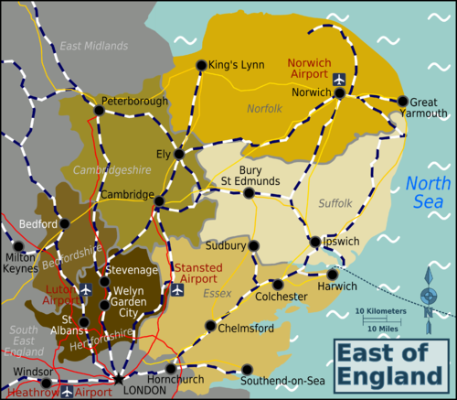
East of England
University of Cambridge- Engineering, Anthropology, Economics, English, History
University of East Anglia- English, Creative Writing, History, American Studies, Geology. Occupational Therapy, Pharmacy, Physiotherapy
Essex University- Creative Writing, Drama, Sport Science
University of Bedfordshire- Sport Science
University of Hertfordshire- Manufacturing Engineering, Food Science, Optometry, Sport Science
Anglia Ruskin University- Agriculture and Forestry, Optometry

Slide 7
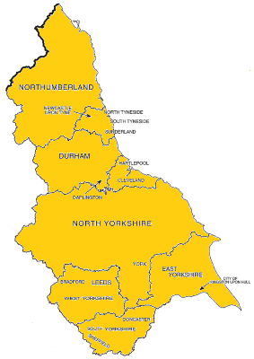
North East England and Scotland
St Andrews- Psychology, Physics, Politics, Geography
University of Edinburgh- Physics
University of Glasgow- Accounting and Finance, Psychology, Physics, Politics, Geography
Northumbria University- Nursing, Occupational Therapy
University of Leeds- English, Environmental Studies, Geography, Economics, Aeronautical Engineering, Computer Science, History, Law, Maths, Nursing, Physics, Psychology, Social policy, Sociology, Sports Science
University of Bradford- Physiotherapy
Leeds Metropolitan University
University of Sheffield- Economics, Aeronautical Engineering, Biological Sciences, History, Politics, Social policy, Sociology, Town Planning
Sheffield Hallam University- Sports Science
University of York- Economics, Chemistry, Biological Sciences, Computer Science, English, History, Law, Nursing, Physics, Politics, Psychology, Social Policy, Sociology
University of Hull- General Engineering
Durham University- Natural Sciences, Environmental Studies, Geography, Classics and Ancient History, Business and Management Studies, Computer Science, Economics, English, French, Maths, Philosophy
Newcastle University- Classics and Ancient History, Business and Management Studies, Media Studies, Dentistry, English, French, Marketing, Medicine, Psychology

Slide 8
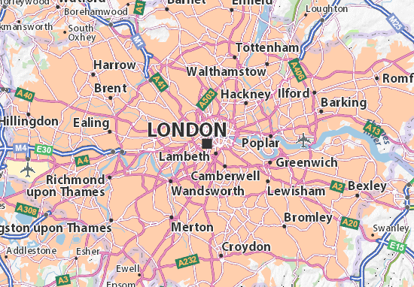
London
LSE,-Accounting and Finance, Anthropology, Business, Economics, Law, Maths, Medicine, Social Policy
Imperial College London- ALL Engineering, Biomedical sciences, Zoology, Chemistry, Computer Science, Maths, Physics
UCL- Anatomy and Physiology, Anthropology, Archaeology, Architecture, Biomedical sciences, Business, Chemistry, Classics, Computer Science, Economics, Electronic Engineering, English, Law, Maths, Medicine
King’s College London- Anatomy and Physiology, Biomedical sciences, Business, Classics, Computer Science, Dentistry, History, War Studies, English, Law, Medicine, Physics
Queen Mary, University of London- Media studies, Dentistry, Law, Medicine
SOAS- Anthropology, East and South Asian Studies, History, African Studies
Brunel University- Anthropology, Creative Writing, Occupational Therapy
St George’s, University of London- Anatomy and Physiology
Goldsmiths, University of London- Anthropology, Media Studies, Psychology
City University- Speech and Language therapy, Business, Media Studies, Nursing
Roehampton University- Anthropology
St Mary’s, Twickenham- Education, Sport
University of Greenwich- Food Science, Psychology, Forensic Science

Slide 9
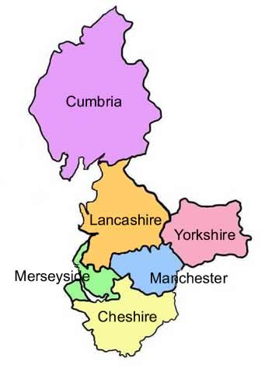
North West England
University of Manchester- English, Environmental Studies, Geography, American Studies, Business and Management Studies. Accounting and Finance, Aeronautical Engineering, Anthropology, Computer Science, Economics, Geography, Politics, Physics, Sociology, Town Planning
University of Lancaster- Accounting and Finance, Business and Management Studies, Biological Sciences, Computer Science, Economics, Geography, Law, Politics, Philosophy, Physics. Sociology
University of Liverpool Business and Management Studies, Aeronautical engineering, Town Planning, Physiotherapy
University of Salford- Physiotherapy
Liverpool John Moores- Sports Science
Liverpool Hope- Sports Science
Manchester Metropolitan University Food Science, Town Planning, Physiotherapy
University of Central Lancashire- Food Science
University of Chester- Food Science

Slide 10
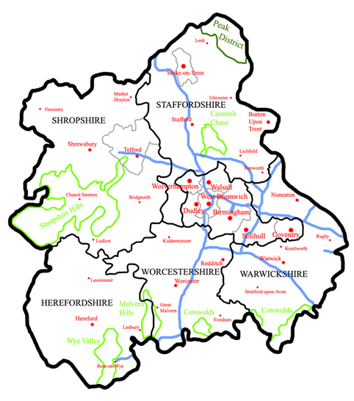
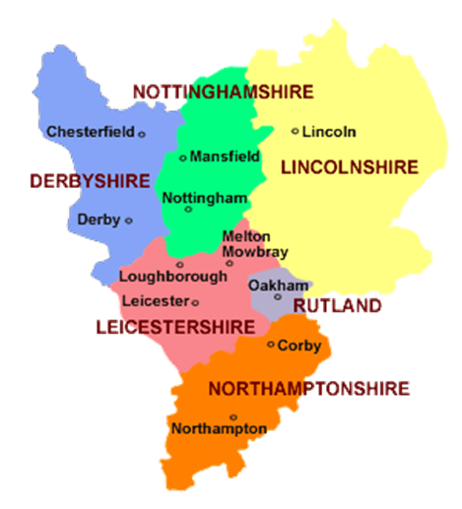
Midlands
University of Birmingham- Physiotherapy, Accounting and Finance, American Studies, Archaeology, Business and Management studies, Classics, Computer Science, Dentistry, Drama, English, History, Psychology, Sports Science, Physics
University of Coventry- Physiotherapy, Art and Design, Drama , Food Science, Sports Science
Keele University-American Studies, Town Planning, Physiotherapy, Medicine
University of Warwick- Accounting and Finance, Business and Management Studies, Classics, Computer Science, Drama, English, History, Law, Maths, Politics, Psychology, Economics, Physics
University of Nottingham- Sports Science, Accounting and Finance, Engineering, English, Creative Writing, Economics, Classics, History, Law, Maths, Politics, Physics, Physiotherapy, Psychology
Nottingham Trent University- Sports Science
Loughborough University- Accounting and Finance, Sports Science, Engineering, Computer Science, Economics, Maths, Politics ,Psychology, Sociology, Town planning

